Slide 1

Multicultural Consultation in the Schools
Felicia castro-villarreal, Phd
Licensed Specialist in School Psychology
The University of Texas at San Antonio

Slide 2
Session Objectives
Attendees will
  Define Culture
  Explore the Context for Consultation in the Schools
  Understand the Need and Rationale for Multicultural Consultation
  Explore Cultural Competency and Multiculturalism
  Learn about MC Consultation Frameworks for practice
  Explore applications of MC Consultation in the Schools

Slide 3
What is culture?
“An integrated pattern of human behavior that includes thoughts, communications, languages, practices, beliefs, values, customs, courtesies, rituals, manners of interacting and roles, relationships and expected behaviors of a racial, ethnic, religious or social group; and the ability to transmit the above to succeeding generations”
- National Center for Cultural Competence - Georgetown University
Notes:
But what is culture?
Culture is a multifaceted construct that needs to be clearly defined in any discussion in which it has a central part. In MSC, culture is defined broadly to include an organized set of thoughts, beliefs, norms for interaction and communication all of which influence behaviors, cognitions, and perceptions.
I also like this video https://www.youtube.com/watch?v=Me2HlTQPS40
https://nccc.georgetown.edu/
So how does one define culture, current perspectives view Culture as a multi-faceted construct that Includes individual identity, group identity, beliefs, values, language, cognition, communication and behavioral patterns
Components shape one’s worldview that determines perceptions of human services, service providers, and service delivery systems (Behring & Ingraham, 1998)
People from the same ethnic or racial group are also “diverse” in terms of SES, education, sexual orientation, individual experiences, or disposition.

Slide 4
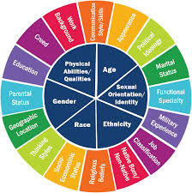
Notes:
See this iceberg http://civet.dedi.velay.greta.fr/sites/default/files/civet/Iceberg.jpg
The iceberg analogy is useful when thinking about the multidimensional and multifaceted nature and complexity of culture.
When we see an iceberg, the portion which is visible above water is, in reality, only a small piece of a much larger whole. Similarly, people often think of culture as the numerous observable characteristics of a group that we can *see* with our eyes, be it their food, dances, dress, dialect, music, arts, or greeting rituals. The reality, however, is that these are merely an external manifestation of the deeper and broader components of culture -- the complex ideas and deeply-held preferences and strong belief systems and priorities known as attitudes, values, and beliefs.
Deep below the "water line" are a culture's Core values. These are primarily learned ideas of what is good, right, desirable, and acceptable -- as well as what is bad, wrong, undesirable, and unacceptable. In many cases, different cultural groups share similar core values (such as "honesty", or "respect", or "family"), but these are often interpreted differently in different situations and incorporated in unique ways into our daily lives. Ultimately, our Interpretations of our core values become visible to the casual observer in the form of Observable Behaviors, such as the words we use, the way we act, the laws we enact, and the ways we communicate with each other.

Slide 5
Cultural Context of US public schools
By 2020, more than half of US children will belong to an ethnic minority group
Over 20% of the population speaks a language other than English
  Spanish
Nearly1 in 4 children has at least one immigrant parent
Approximately 21% of school children live in poverty
  39% AA & 33% Hispanics are living in poverty
  About half of US public school students qualify for free and reduced lunch
Approximately 1/3 of all school-aged children come from a single parent household
  54% of AA children come from single parent homes
SPED student population is still roughly 13%
  Learning Disabilities
The number of LBGTQ and gender non-conforming youth is growing
  Higher risk for increased interactions with law enforcement & the criminal justice system, mental illness & homelessness
According to the Pew Research group, 1 in 4 millennial youth claim no religious affiliation
Notes:
The culture of US public schools is changing the cultural and linguistic backgrounds of the students we work with is likewise changing.
This increasing CL Diversity of often perceived as a challenge for service providers who work with diverse students and in diverse contexts. One of the major challenges is the cultural mismatch between clients and providers since providers carry cultural and social attitudes that may influence their own actions and perceptions of diverse groups. Cultural responsive training is a necessity for school based mental health professionals
AA: African-American
Simply provides a snapshot of the cultural landscape

Slide 6
Cultural context of Oklahoma City Public Schools
Serving 44,253 students
Languages
18,000 bilingual students
Students
33 elementary schools
13 middle schools
9 high schools
2 alternative schools
9 charter schools
Ethnic makeup
2% Asian
3% Native American
14% Caucasian
22% African American
54% Hispanic
.2% Hawaiian/Pacific Islander
5% Multiracial
Schools
Languages spoken at home
English 59%
Spanish 39%
Other 2%
13,000 ELL
Special education students: 5,517
Economically disadvantaged students: 83%
Homeless students: 3,068
Oklahoma City Public Schools. (2018). Oklahoma City Public Schools Statistical Profile 2017-2018. Retrieved from https://www.okcps.org/cms/lib/OK01913268/Centricity/Domain/96/2017-2018%20STATISTICAL%20PROFILE.pdf
Notes:
ELL: english language learners

Slide 7
Professional context
School Psychologists in the United States
  Ethnicity: 88% White, 6% Hispanic, 5% AA, 3% Asian, .2% American Indian,
  Gender: 83% Female
  7% Bilingual and fluent in Spanish
Currently experiencing a shortage of qualified professionals to meet the demands and needs of our students
(Walcott, Charvat, McNamara, & Hyson, 2016; Walcott & Hyson, 2018)
Notes:
There is a steady increase in ethnicity diversity over time, with a 7% increase in non-White school psychologists since 1990 (94% of respondents were White) (Walcott & Hyson, 2018).

Slide 8
Implications for practice
In light of these estimates, those who work in schools need to be prepared to work with all children.
School psychologists need to be trained in culturally responsive practices to meet the needs of an increasing number of culturally and linguistically students and families.
Notes:
One of my primary goals is to expand your thinking about school based consultation by highlighting key issues related to culture that have key implications for your practice and multicultural consultation in the schools

Slide 9
Rationale for multicultural training in school Psychology
Cultural Context
Ethical Standards and Professional Guidelines provided by NASP (2010) and APA (2002) to address the needs of this growing population
  NASP Strategic plan (2017) and commitment to culturally competent practice
Court cases, civil rights legislation
Research showing a link between cultural competent practice and outcomes
The most compelling rationale for improving and intensifying multicultural training in school psychology is the significant change in the demographic profile of our nation and our schools
Notes:
In addition to the context and in response to the changing demographics

Slide 10
Training in multicultural school psychology
Though we’ve been discussing culture, competency, responsive practice, and social justice for decades, we are still lacking in models and methods for training
  School psychology graduate students report inadequate training in cultural diversity and social justice
  Feel inadequately prepared
A major challenge is universal application of existing theoretical frameworks and research findings while ignoring integration of multicultural and cross cultural knowledge bases
Still not routinely infusing culture into practice
Notes:
Research on training in cultural diversity and multiculturalism

Slide 11
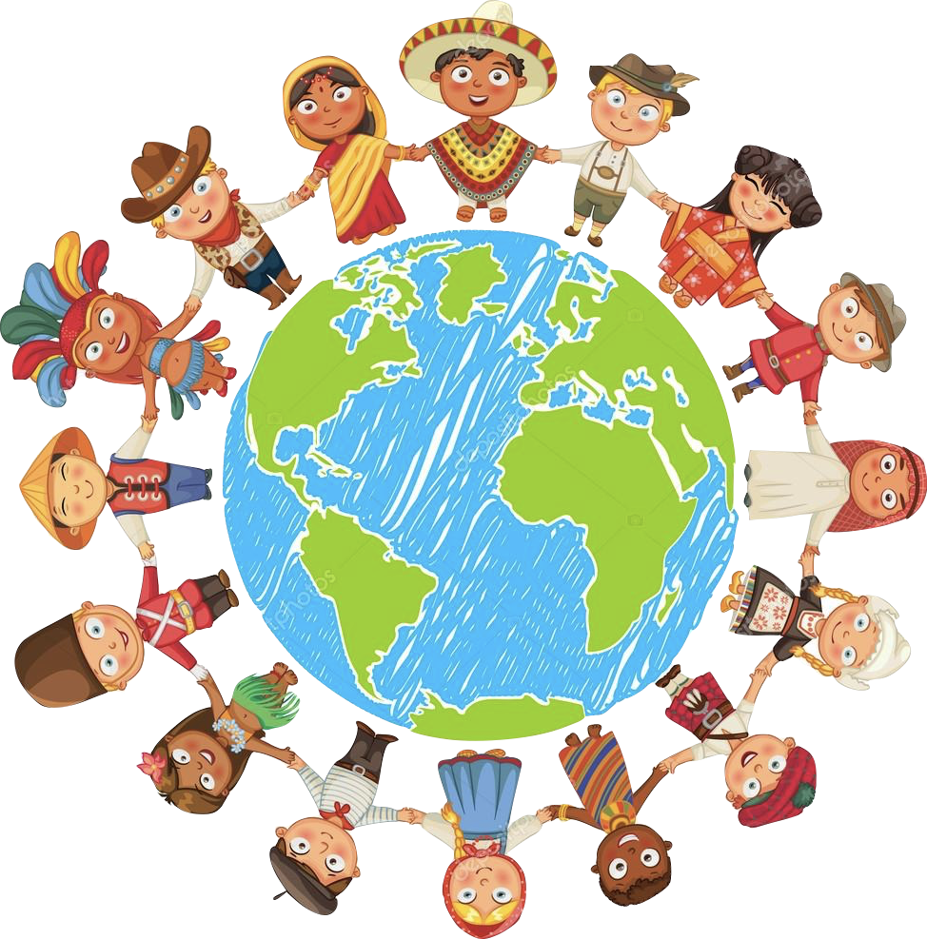
Meeting the Needs of CLD students in the schools:
The Need for Multiculturalism and CR practice

Slide 12
Multiculturalism and Cultural Competence
As practiced in schools, multiculturalism
“is a process, an ideology, and a set of interventions in which school psychologists and other culturally competent professionals engage. It is a worldview that recognizes and values the uniqueness of diverse learners, cultural backgrounds, and identities.”
(Carroll, 2009, p.2)
Notes:
How do we begin to feel prepared to meet the needs of diverse students and families?
Through The Development of multiculturalism and cultural competence
Multiculturalism is a worldview that recognizes and values the uniqueness of diverse learners, cultural backgrounds, and identities.
Recognizes broad dimensions of individual identity, including “race, ethnicity, language, sexual orientation [sexual expression/identity], gender, age, disability, class status, education, religious/spiritual orientation, and other cultural dimensions” (APA multicultural practice guidelines and standards, 2002, p. 9).
Because “culture” as we have learned is a term that has broad meaning and implications and given that there are numerous differential behavioral and cognitive patterns reflected within groups, the recognition of and appreciation for individual differences may best reflect the essence of multiculturalism (Sheridan, 2000).

Slide 13
Cultural Competence
“To be culturally competent doesn't mean you are an authority in the values and beliefs of every culture. What it means is that you hold a deep respect for cultural differences and are eager to learn, and willing to accept, that there are many ways of viewing the world.”
Okokon O. Udo
Notes:
The integration and transformation of knowledge about individuals and groups of people into specific standards, policies, practices, and attitudes used in appropriate cultural settings to increase the quality of services, thereby producing better outcomes (National Technical Assistance Center for State Mental Health Planning-Davis, 1997)
The ability to think, feel, and act in ways that acknowledge, respect, and build upon, ethnic, socio-cultural and linguistic diversity
Cultural Competence is the key factor in enabling educators to be effective with diverse population (Lynch and Hanson, 1998)

Slide 14
Cultural Responsiveness
Cultural competence and responsive are used interchangeably but more currently transformative practice is referred to as responsive practice and reflects the notion that cc is never fully achieved, there is no endpoint, and we are always on a journey towards improved responsiveness.
“Taken together, these elements require educators not only to understand core psychological and social attributes of the cultural heritage of their students, but also to actively make and sustain real connections between children’s lived experiences in the various contexts of their lives. Innovative facilitators/consultants will need to be culturally responsive themselves as they work to create a fit between innovation and the organizational and psychological context of a school.”
(Knotek, 2012)
Notes:
Cultural competence and responsive are used interchangeably but more currently transformative practice is referred to as responsive practice and reflects that cc is never fully achieved there are no endpoints and we are always on a journey towards improved reponsiveness there are nonetheless some basic elements that embody repsponsive practice and that includes
“Taken together, these elements require educators not only to understand core psychological and social attributes of the cultural heritage of their students, but also to actively make and sustain real connections between children’s lived experiences in the various contexts of their lives. Innovative facilitators/consultants will need to be culturally responsive themselves as they work to create a fit between an innovative and the organizational and psychological context of a school.”
Knotek, 2012

Slide 15
Action steps for school psychologists
School Psychologist Know Thy Self
Increase awareness of identity characteristics
Awareness is a necessary precursor to understanding one’s personal and professional selves
School psychologists’ identity characteristics can impact their biases and prejudices
Increase Knowledge About Racially Diverse Populations
Use research to gain understanding of educational challenges related to specific populations
Use web based resources to build knowledge related to specific populations
Join professional organizations/groups that aim to understand and improve racially diverse students’ educational experiences
Skills Application
Use data that documents racial disparities in outcomes (e.g., special education, discipline, etc.) as basis for school-based access
Find social justice allies in school settings (administrators, teachers, support personnel, etc.)
Conduct professional development on issues related to racial and social justice such as bias in assessment, special education disproportionality based on race, teacher bias, etc.
Develop Action Plan
(Sullivan et. al, 2017)
Notes:
Here are 3 very important steps toward cultural competence and responsive practice: dive deep into learning about yourself, your sociocutlural history, your professional and personal, and cultural identity.
Dive into the sociocultural and linguistic cultures of your students and families.
Learn about how your students fair, and examine data to understand racial disparities in outcomes. Find racial and social justice allies, conduct professional development on issues related to racial and social justice in such
Sue el al. (1992) tripartite approach to multicultural competence:
Awareness of how one’s own culture has impacted his or her worldview, values, behavior and biases.
Ongoing acquisition of knowledge other cultures’ worldviews and value without judgement.
Making intentional efforts to provide culturally responsive intervention.
Sue’s tipartate model is the most widely adopted approach to multicultural competency training. With this approach culturally responsive clinicians demonstrate skills along three dimensions

Slide 16
Multicultural “Flashpoints” Toward Cultural Competence & Responsive Practice
Action
Awareness
Advocacy
Acknowledgment &
Knowledge
Adapted from Carroll (2009) in J. Jones, The Psychology of Multiculturalism in the Schools.
Notes:
Put another way, This slide depicts the process that individuals take on their journey towards becoming culturally competent school psychologists. Carroll describes these four critical skill sets as “flashpoints” or definable, measurable evidence of multicultural practices/ activities or actions/policies. The flashpoints are interdependent and build upon one another. They begin with awareness which is generally the purpose of this presentation- to raise awareness about what multiculturalism is and its importance to school psychologists’ work.
Knowledge would involve acquiring specific skills and information related to your work with diverse cultural groups. For instance, you might want more information about how to conduct a fair assessment of students who are culturally or linguistically different. For such skill development, I encourage you to look through the NASP Program (particularly since it is so early in the convention) to see what sessions address such topics. One excellent reference book, though, that walks you through best practices for assessing culturally and linguistically diverse students is, Assessing Culturally and Linguistically Diverse Students: A Practical Guide. This book is authored by Robert Rhodes, Salvador Ochoa, and Samuel Ortiz.
Advocacy would be the transformative practice involving advocating for those without a voice, marginalized, and the vulnerable. Knowing and understanding inequality and ethnic and racial disparities to advocate for equity for all.
Let’s refocus and take a look at the awareness flashpoint which begins with the school psychologist’s awareness of one’s own self as a cultural being. We each have multiple identities that overlap and/or intersect. Janine Jones, in the chapter she wrote for the book she edited, recommends journaling as a way for practitioners to get in touch with their personal biases. She notes that journals can be used without fear of judgment by others, but can serve as a tool for self-analysis and self-awareness.

Slide 17
Step1: Know thyself
“He who knows others is wise; he who knows himself is enlightened.” “The first thing you have to know is yourself. A man who knows himself can step outside himself and watch his own reactions like an observer.” “Your own Self-Realization is the greatest service you can render the world.”
- Plato
Notes:
Being able to see yourself as a cultural being will facilitate your connection with your students as members of various cultural groups. This serves as the foundation for developing your multicultural competence with diverse children and families.

Slide 18
We All Belong To Cultural Groups
Mexican
Tejana / ST
American
Middle / working Class
Notes:
Everyone belongs to some cultural group, and most of us belong to several different cultural groups. This slide represents four of the cultural groups to which I belong. The overlap in the middle represents my American cultural identity. Those within each cultural group share, to some extent, values, language, and beliefs although it is important to remember there is within group variability. Take a moment to consider what cultural groups you belong to. Being able to see yourself as a cultural being will facilitate your connection with your students as members of various cultural groups. This serves as the foundation for developing your multicultural competence with diverse children and families.
ADDRESSING FRAMEWORK????? PAIR AND SHARE!!!!

Slide 19
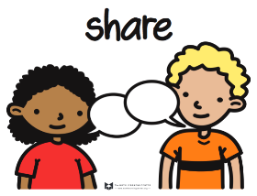
Pair & Share: Use the ADDRESSING framework as one way to look inward and better understand those you work with
ADDRESSING framework: Age, Developmental Disability, Acquired disability, Religion, Ethnicity, SES, Sexual orientation, Indigenous heritage, National origin, Gender (Hays, 2001)
Notes:
Pam hays (2001) offers a practical approach to psychologists working in multicultural contexts and cross cultural relationships. Pam hays proposes the addressing framework for assessing the psychologists own capacity to work in a multicultural context. So often, we imagine assessment to only refer to the client or consultee. Hays asks psychologists to examine their own identities using the folloiwng formula: Age and generational influences, developmental and acquired disabilities, religion and spiritual orientation, ethnicity, SES, sexual orientation, indigenous heritage, national origin, gender, to consider your beliefs regarding that dimension and if you fall within the dominant culture or minority/marginalized, privileged or vulnerable????
The addressing framework, conceptualizes cross cultural work as involving two broad categories of effort by the psychologist. The first category concerns the psychologists personal self exploration and growth; key to this process is the a growing understanding of the influence of culture on ones own belief system and world view, the second category consists of the psychologists self education about the clients/consultees cultures which usually leads to a deeper understanding of the client and consultee.

Slide 20
The Students and Families We Work With Also Belong To Cultural Groups
Consider all of the cultural groups your students might belong to…
Racial / Ethnic / Social / linguistic
Religious / Spirituality
LBGTQ
School Sub-cultures (e.g., athletes, skaters, dancers, band, drama, chess, cheerleaders)
Disability (e.g., Deaf Culture, SPED, GENED, physical disability)
Homeless
Foster
Immigrants
Notes:
Next, School personnel should identify what cultural groups are represented in the school by obtaining state and local demographics. Information about available programs, types of services etc.
“know the territory” After looking and searching within, take the time to study the demographic makeup of your setting and to get to know what goes on during each school day. Get to know the organizational atmosphere and the neighborhoods within which our schools are situated and our students live. Such in depth analysis will lead to uncovering regular patterns and insights as well as the generation of hypotheses that ultimately will facilitate the consultants work.
The students we service also belong to various cultural groups. Cultural groups that might come to mind immediately include racial/ethnic groups and religious groups. What other potential cultural groups can you think of? Now, consider how might a student’s membership in these cultural groups impact your service delivery as a school psychologist?
Let’s focus on youth culture. I’m choosing to focus on youth culture because I want you all to really begin considering all of the multiple and intersecting cultural groups your students belong to.
Consider Oakland’s three-tiered hierarchical model of culture shared earlier. At level 3, how might preferences for language and communication be influenced by a student’s membership in youth culture? For youth, technology (i.e., cell phones for texting and calling, social networking sites, etc.) plays a huge role in their communication. Are you aware of the language associated with such culture?
Let’s test your knowledge of the language of “the internet” which youth use to communicate.

Slide 21

Multicultural Consultation
“Our culturally and linguistically diverse students have a right to equitable learning opportunities. This is especially true for students who are our most vulnerable and for whom learning and achieving may not come so readily.”
Castro-Villarreal, F. & Nichols, S.L. (2016). Intersections of accountability and special education: The social justice implications of policy and practice. Teachers College Record, 118 (14), 1-11.
Notes:
Multicultural awareness and sensitivity espoused by this consultation model will help us to narrow gaps and edge us closer to equity.

Slide 22
Multicultural Consultation Defined
Recently, the term multicultural consultation has been introduced in the literature as a culturally sensitive indirect service in which the consultant adjusts the consultation services to address the needs and cultural values of the consultee and/or the client (Tarver Behring & Ingraham, 1998).
Learning and development of the consultant, cultural variations in the consultation constellation, contextual and power issues, and methods to support consultee and client success (Ingraham, 2000).
Effective consultation is dependent upon our understanding of the diverse population we serve, our ability to work with individuals from varied cultures, and our capacity for conducting assessments and developing interventions that can fulfill the diverse needs of clients (e.g., students), consultees (e.g., parents, teachers) and systems (e.g., parents, teachers) (Nastasi et al., 2000).
Notes:
Cultural uniqueness
Building bridges
Is an approach to consultation in which multicultural issues are raised and adjustments in traditional consultation practices are made. MC is defined as, culturally sensitive indirect service in which the consultant adjusts the consultation services to address the needs and cultural values of the consultee or client or both.

Slide 23
Multicultural consultation
A framework or lens for understanding the influence of these sociocultural factors in consultation
Consultants are required to be aware of their own values and potential biases and be sensitive to cultural values and practices of the consultee
Consulting with multicultural lens means supporting consultees development of cultural competence, practicing and modeling cultural responsiveness, and co-constructing new understandings of the problem

Slide 24
Multicultural consultation
A fundamental element of developing multicultural competence is consideration of intersecting identities, perspectives, and lenses through which to interpret events and behaviors
The goal of consultation is to reduce academic, behavioral, and mental health difficulties from worsening so students can remain in the general education setting
  The goal is the same for multicultural consultation but there is an increased emphasis on ensuring that these similar outcomes are achieved for minority students who experience a disproportionate amount of negative outcomes
Notes:
A multicultural approach to consultation considers the influence of the culture of each member of the triad in every step of the process (Ingraham, 2004

Slide 25
Cross-Cultural Consultation Competencies
Understand your culture and others’ culture
Develop cross-cultural communication and interpersonal skills
Examine culturally-embedded context
Use qualitative methods to gather information
Acquire culture-specific knowledge
Collaboration with translators
Rogers, M. (2000). Examining the cultural context of consultation. School Psychology Review, 29(3), 414-418.
Notes:
Learning and skill development in multicultural consultation: Consultants: consulting school psychologists must understand their own culture and how it impacts others, must respect and value other cultures, and must learn how to design and implment culturally appropriate interventions.
There are core cross cultural competencies outlined by APA (2002) There are some basic competencies when thinking about multicltural consjltation and include understandinga nd learning ourselves and our cultural, personal, and professional identies, developing cross cultural interpersonal communication skills, how to work with those differnet from us, in depth and purposeful examination of context, qualitiative inquiry so looking for data but what about context and ecology is important here?

Slide 26
School Consultation Models
Behavioral Consultation
Conjoint Behavioral
A systematic indirect form of service delivery in which two or more persons work together to identify, analyze, remediate, and evaluate a client’s needs.
Use of a standard 4-stage problem solving process
Adherence to behavioral assessment techniques
Reliance on behavioral intervention strategies
Evaluation of outcomes based upon behavioral analysis and related methodologies
An extension of behavioral consultation that incorporates home and school participation in the intervention process.
Allowing for cultural considerations of behaviors
Family engagement to improve student outcomes
Parents and teachers are utilized as valuable resources of information
Sensitive to social justice issues (e.g. immigration status, past experiences in the school system, etc.)
Jones, J.M. (2009). The psychology of multiculturalism in the schools. Maryland: NASP Publications.
  Sheridan, S. (2009) Considerations of multiculturalism and diversity in behavioral consultation with parents and teachers. School Psychology Review 29(3) 344-353.
Notes:
Problem solving is the number one reported model in school psychology (Newman and colleagues, 2015). Behavioral problem-solving consultation is reported as the most frequently taught and implemented in school psychology (Newman, Barrett, & Hazel, 2015).

Slide 27
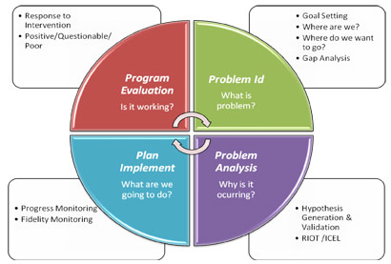
Behavioral Problem-Solving Model
Jones, J.M. (2009). The psychology of multiculturalism in the schools. Maryland: NASP Publications.
Notes:
The problem solving process is the essence of consultation and typically follows four stages.
Cultural issues may emerge during any one of the stages: Establish a cooperative relationship, develop a trusting relationship
Problem definition and analysis: don’t contrue cultural differences as the problem. However cultural differences must be recognized and acknowledged during this stage so appropriate interventions can be developed.
Goals and intervention development: cultural differences may lead to mismatched goals and expectations. Treatment integrity will be maxmized if the interventions goals and plans are develped in a culturally sensitive and cooperative manner.

Slide 28
Frameworks in Multicultural School consultation

Slide 29
Prominent frameworks in Multicultural School Consultation
Participatory Culture Specific Intervention Model (Nastasi et al. 2004)
Cultural Sensitivity Framework (Resnicow et al., 1999)
Consultee-Centered (Hylander, 2012)

Slide 30
Ingraham’s Multicultural Consultation Approach
Eight Domains for Consultant Learning and Development (Ingraham, 2000)
Understanding one’s own culture
Understanding the impact of one’s own culture on others
Respecting and valuing other cultures
Understanding individual differences within cultural groups and the multiple cultural identities prevalent in many individuals
Cross-cultural communication and multicultural consultation approaches for developing and maintaining rapport
Understanding cultural saliency and how to build bridges across differences
Understanding the cultural context for consultation
Multicultural consultation and interventions appropriate for the consultees and clients

Slide 31
Components of MC School Consultation (Ingraham, 2000)
Methods for supporting the consultee and client
Framing the problem and the consultation process
  Value multiple perspectives
  Create emotional safety and motivational support
  Balance affective support with new learning
  Build on principles for adult learning
  Seek systems interventions to support learning and development
Potential multicultural consultation strategies for working with consultees
  Support cross-cultural learning and motivation
  Model bridging and processes for cross-cultural learning
  Use consultation methods matched with the consultee’s style
  Work to build consultee confidence and self-efficacy
  Work to increase knowledge, skill, and objectivity
Continue ones professional development and reflective thinking
  Continue to learn
  Engage in formal and informal continuing professional development
  Seek feedback
  Seek cultural guides and teachers
(Ingraham, 2000)

Slide 32
Bernal’s Ecological Validity Model for adapting EBi
Ecological Validity Model (Bernal, Bonilla, & Bellido, 1995)
Originally conceptualized for Latino populations
Systematic framework for adapting EBIs
Outlined rules and tenants for making cultural adaptations and modifications to EBI
8 essential features to adapt and modify EBIs
Notes:
IDEA is to MAINTAIN The tenents, active ingredients, or change agents and structures stay in place but you seek to tweek and modify, and adapt to the meet the unique needs of your population.
In their Ecological validity model, they are focused on external validity, is the environment as experienced by the student/client the same as the therapist assumes it is experienced in treatment?
Most EBTs are conducted with white, educated, verbal, and middle class patients and may not generalize to ethnic minorities.
Social Validity
Here you consider the acceptability and viability of the intervention by the community
Based on some communities that may respond poorly to EBP approaches

Slide 33
Ecological Validity Model (Bernal, Bonilla, & Bellido, 1995)
Language
Concepts
Goals
Methods
Persons
Metaphor
Content
Context

Slide 34

Applying the Framework: Culturally responsive PBIS

Slide 35
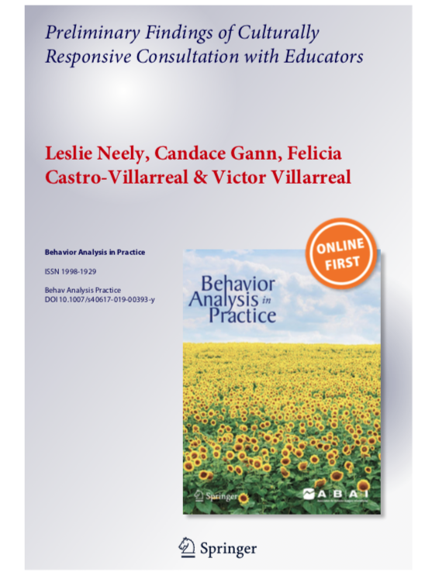
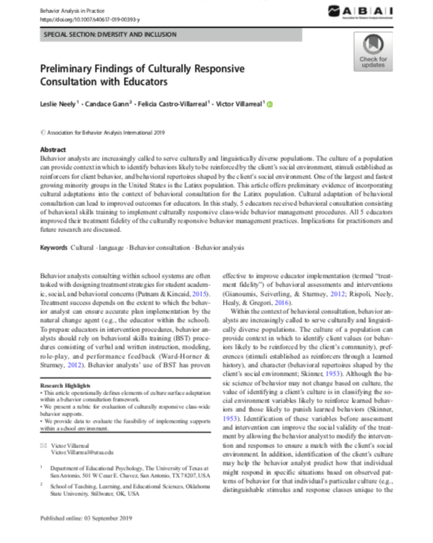
(Neely, Gann, Castro-Villarreal, & Villarreal, 2019)
Notes:
Castro-Villarreal and colleagues conducted action research in an urban culturally and linguistically diverse setting
Followed consultation and coaching best practices framework
Large group didactic training followed by individual researcher provided coaching support

Slide 36
The Ecological Validity Model in Practice
Considered the Context via Extensive Mapping, needs assessment, & “getting to know the territory”
Considered cultural adaptations by element
  Language
  Persons
  Metaphor
  Content
  Concepts
  Goals
  Methods
  Context
Notes:
Many training programs in cultural competency tend to be general and descriptive in nature leaving professionals with an increased awareness and understanding of important issues but with few practical skills to incorporate into clinical practice/school based practice.

Slide 37
Multicultural Consultation:
Culturally Responsive PBIS
Participants
A total of six educators from two university-supported laboratory schools enrolled in this study.
  Five of the educators completed the entire study.
  The sixth educator (Educator F) did not complete the study due to personal medical complications.
Four of the six educators were general education teachers and two were bilingual education teachers

Slide 38
Multicultural Consultation:
Culturally Responsive PBIS
Procedures
Baseline
  During baseline, each teacher was instructed to conduct lessons as usual. No feedback or direction was provided during this time. Behavioral observations were conducted using the researcher developed culturally responsive classroom management evaluation tool (available upon request from Dr. Castro-Villarreal)
Coaching
  The intervention and consultation phase composed of an initial small group training and follow-up individual coaching sessions. Follow-up individual coaching sessions were conducted in the teacher’s classrooms during their conference periods and lasted between 10-30 minutes each.

Slide 40
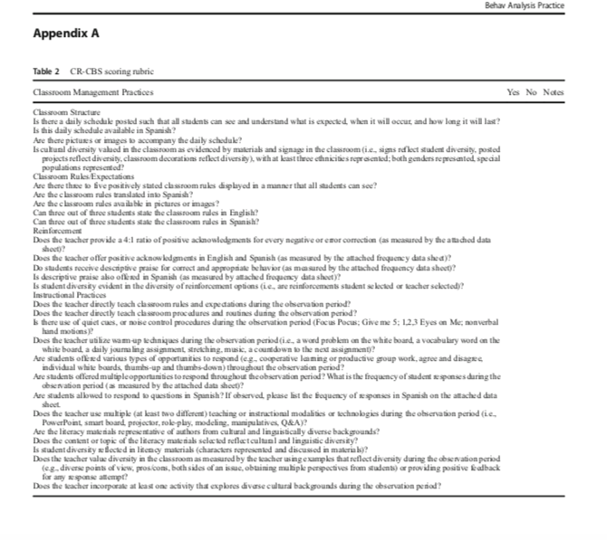
(Neely, Castro-Villarreal, & Villarreal, 2019)

Slide 41
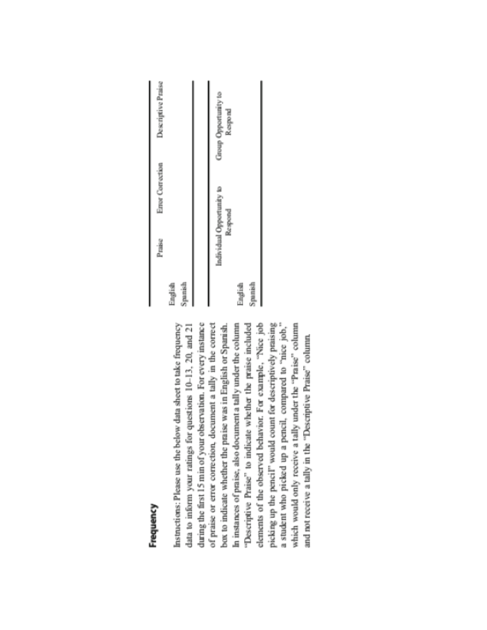
(Neely, Gann, Castro-Villarreal, & Villarreal, 2019)

Slide 42
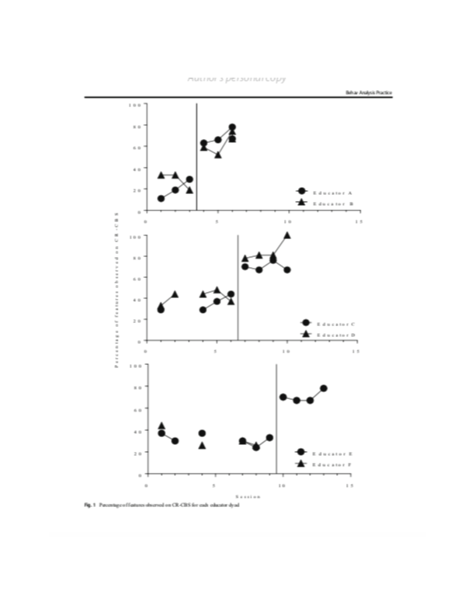
Results
(Neely, Gann, Castro-Villarreal, & Villarreal, 2019)

Slide 43
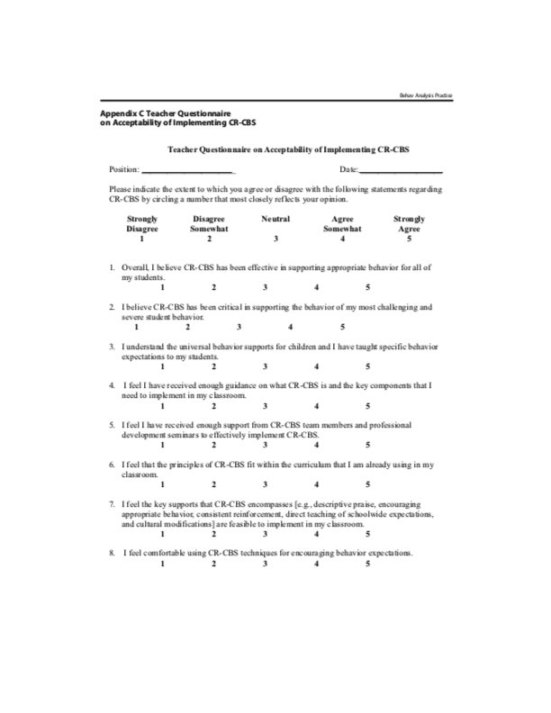
(Neely, Castro-Villarreal, & Villarreal, 2019)

Slide 45
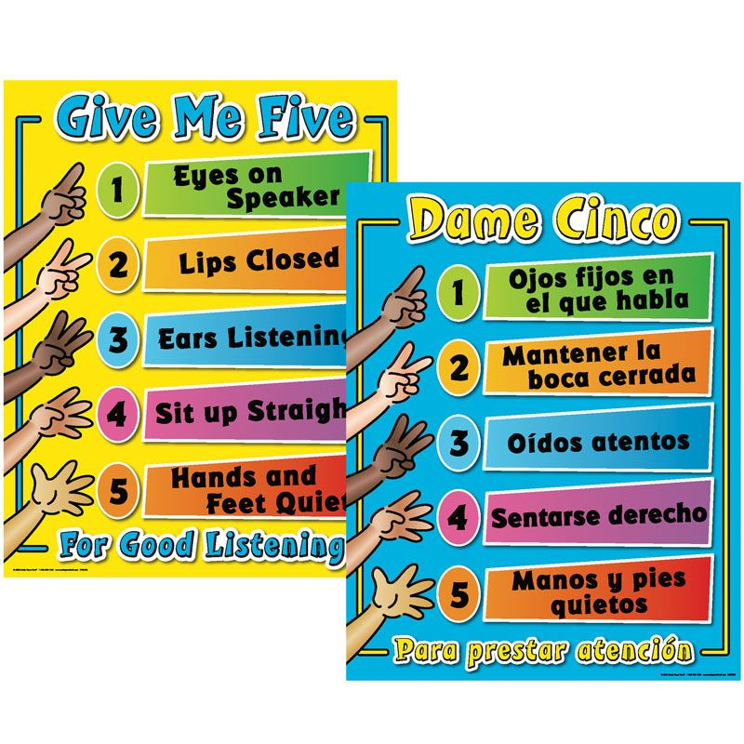
Notes:
Changes: Reformat slide

Slide 46
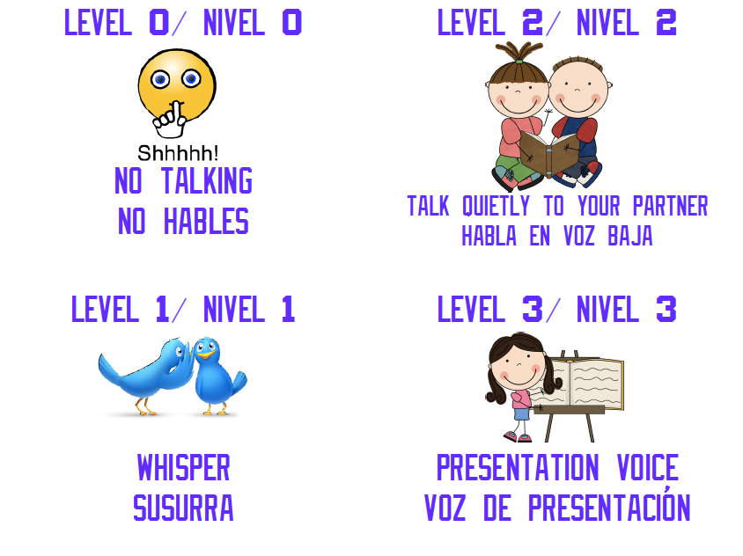

Slide 47
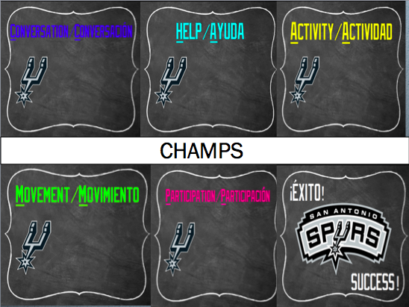

Slide 48
Applying the Framework: Culturally Responsive Consultee-Centered Consultation

Slide 49
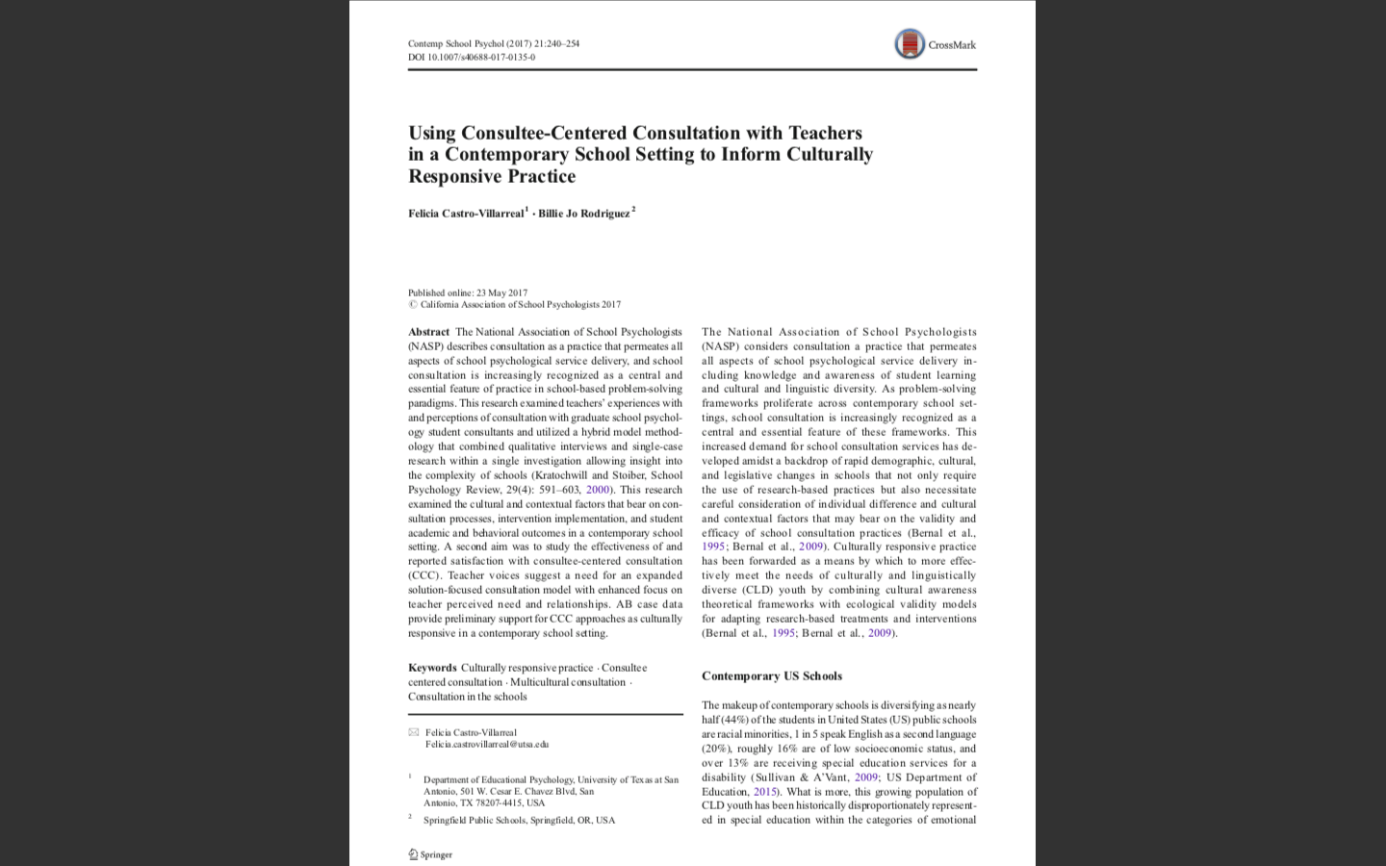
Castro-Villarreal & Rodriguez (2017).

Slide 50
Culturally Responsive Consultation in a Contemporary School Setting
Consultee-Centered Consultation was conducted with teachers in a high risk culturally and linguistically diverse setting
Methods included:
  Qualitative and Grounded Theory and Constant Comparison Analysis
  Quantitative Single-case research design
Examined the cultural and contextual features that bear on consultation processes
Examined teacher satisfaction with a consultee-centered approach
Examined the effectiveness of interdependent group contingency on student on-task behavior and work completion
Notes:
The consultee starts the process by asking the consultant for professional advice or help about an issue that the consultee believes is within the consultant’s area of competence.
Consultees are free to take and reject the advice from the consultant.
The consultant shifts between confirming the consultees’ original representation of a problem and challenging that representation.
The consultant is nondirective, listening, and confirming.
In the neutral position the consultant is active and structuring.
In the moving away position the consultant is active and very collaborative giving proposals and suggestions.
The essence of the dynamic is that the consultant uses a very different approach in the different modes of interaction. In the mode of approach the consultant is taking on a nondirective role, whereas in the interaction modes of free neutral and moving away, the approach is much more directive.

Slide 51
Theoretical and Conceptual Influences
Culturally Responsive practice was influenced by Ingraham’s multicultural consultation framework
Behavioral problem-solving model provided the structure
Consultee-Centered Consultation guided the process

Slide 52
Castro-Villarreal & Rodriguez (2017).

Slide 53
Consultee Centered Consultation in a Contemporary School Setting GT: Findings and Results
Teacher consultees talked about the importance of recognizing and considering unique school and student culture
Teachers prefer a collaborative approach and dislike a problem focus
Teachers unfamiliar with consultation as a service delivery option
Teachers prefer a solution focused
Teachers tend to mistrust outside consultants and school psychologists operating in a different role
Flexibility
Desire for direct service delivery as well
Satisfied and reported to prefer a consultee-centered approach

Slide 54
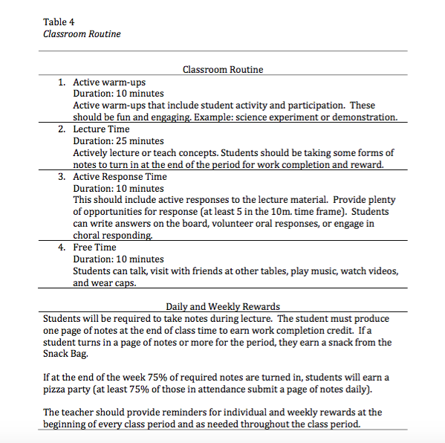
Castro-Villarreal & Rodriguez (2017).

Slide 55
Single Case Results
Castro-Villarreal & Rodriguez (2017).
Notes:
AB quasi-single-case study
Implemented a structured and timed classroom routine and contingency management component
Independent and interdependent
Intervention resulted in increased on-task behavior
Intervention resulted in increased work completion

Slide 56
Implications for practice: How to incorporate culturally responsive practices in our work
Relationships and diversity of content offerings are key
Not just about skin color and language but about being open, available, and responsive
Persons: Must consider the importance of the teacher in terms of experience, quality, and ethnic/cultural background
“solution-seeking approach” where we build on student’s strengths to develop interventions, always work from a strengths based perspective
Culturally responsive literacy instruction aims to bridge the gap between reading and the world/cultures students live in
Content: literature that focuses on people of color, religious minorities, the disabled
Multiethnic literature that is outside the literary canon or recommended book lists encourages participation from diverse groups

Slide 57

Build Trusting Relationships
Spend time getting to know families and introducing yourself
Learn as much as possible about unique cultures
  Read books about different cultures
  Watch videos about cultural values and practices
  Talk to people from different cultures
  LEARN YOUR CULTURE & THE CULTURE OF THOSE YOU WORK WITH
Develop on-going relationships with families
Refrain from making cultural assumptions and generalizations about family
  Avoid stereotyping families who belong to certain cultural groups

Slide 58
Address Diversity Issues Directly
Demonstrate an interest and respect for different cultural styles
Learn about the family’s beliefs and values from family members themselves
Provide workshops and booklets for families about living in two cultures and cross-cultural parenting
Offer workshops to empower parents to work effectively with American schools
  Topics may include how: U. S. schools function; school structures, rules, and responsibilities; requirements for mandated reporting by school personnel of suspected child abuse; rights and responsibilities of students and parents; free services and resources

Slide 59
references
Behring, S. T., & Ingraham, C. L. (1998). Culture as a central component of consultation: A call to the field. Journal of Educational and Psychological Consultation, 9(1), 57-72. doi:10.1207/s1532768xjepc0901_3.
Bernal, G. & Jimenez-Chafey, M. I. (2009). Cultural adaptations of treatments: A resource for considering culture in evidence-based practice. Professional Psychology: Research and Practice, 40(4), 361-368.
Bernal, G., Bonilla, J., & Bellido, C. (1995). Ecological Validity and cultural sensitivity for outcome research: Issues for cultural adaptation and development of psychosocial treatments with Hispanics. Journal of Abnormal Child Psychology, 67-82.
Castro-Villarreal, F. & Nichols, S. L. (2016). Intersections of accountability and special education: the social justice implications of policy and practice. Teachers College Record, 118(14), 1-11.
Castro-Villarreal, F., & Rodriguez, B. J. (2017). Using Consultee-Centered Consultation with Teachers in a Contemporary School Setting to Inform Culturally Responsive Practice. Contemporary School Psychology, 21(3), 240-254.
Goforth, A., Pham, A., Chun, H., & Castro-Olivo, S. (2017). Acculturation and Sociocultural Factors in Children’s Mental Health Services: Applying Multicultural Consultation Frameworks. Journal of Educational and Psychological Consultation, 27(3), 239-244. doi:10.1080/10474412.2016.1275650
Hylander, I. (2012). Conceptual change through consultee-centered consultation: A theoretical model. Consulting Psychology Journal: Practice and Research, 64(1), 29-45.
Ingraham, C. L. (2017). Educating Consultants for Multicultural Practice of Consultee-Centered Consultation. Journal of Educational and Psychological Consultation, 27(1), 72-95. doi:10.1080/10474412.2016.1174936
Ingraham, C. L. (2000). Consultation through a multicultural lens: Multicultural and Crosscultural consultation in schools. School Psychology Review, 29, 320-343.
Jones, J. M., Kawena Begay, K., Nakagawa, Y., Cevasco, M., & Sit, J. (2016). Multicultural Counseling Competence Training: Adding Value With Multicultural Consultation. Journal of Educational and Psychological Consultation, 26(3), 241-265. doi:10.1080/10474412.2015.1012671
Jones, J. M. (Ed.) (2009). The psychology of multiculturalism in the schools: A primer for practice, training, and research. Maryland: National Association of School Psychologists.
Knotek, S. E. (2012). Utilizing culturally responsive consultation to support innovation implementation in a rural school. Consulting Psychology Journal: Practice and Research, 64(1), 46-62. doi:10.1037/a0027993

Slide 60
references
Meyers, J., & Varjas, K. (2016). An Agenda for Research and Practice Related to Multicultural Approaches to School-Based Consultation. Journal of Educational and Psychological Consultation, 26(3), 304-311. doi:/10.1080/10474412.2016.1187569
Nastasi, B. K., Varjas, K., Bernstein, R., & Jayasena, A. (2000). Conducting participatory culture-specific consultation: A global perspective on multicultural consultation. School Psychology Review, 29, 401-413.
National Association of School Psychologists. (2017). National Association of School Psychologists strategic plan: 2017–2022. Bethesda, MD: Author. Retrieved from http://www.nasponline.org/utility/about-nasp/vision-core-purpose-core-values-and-strategic-goals
National Association of School Psychologists [NASP] (2010). National Association of School Psychologists Principles for Professional Ethics. Bethesda, MD: Author. Retrieved from: http://www.nasponline.org. U.S. Department of Education, National Center for Education Statistics, Common Core of Data (CCD). (2016-17). State Nonfiscal Public Elementary/Secondary Education Survey. Retrieved from https://nces.ed.gov/ccd/elsi/expresstables.aspx?bridge=quickFacts&tableid=13&level=State&year=2016-17.
McFarland, J., Hussar, B., Zhang, J., Wang, X., Wang, K., Hein, S., Diliberti, M., Forrest Cataldi, E., Bullock Mann, F., & Barmer, A. (2019). The Condition of Education 2019 (NCES 2019-144). U.S. Department of Education. Washington, DC: National Center for Education Statistics. Retrieved from https://nces.ed.gov/ pubsearch/pubsinfo.asp?pubid=2019144
Neely, L., Gann, C., Castro-Villarreal, F., & Villarreal, V. (2019). Preliminary Findings of Culturally Responsive Consultation with Educators. Behavior Analysis in Practice, 1-12. doi:/10.1007/s40617-019-00393-y
Newman, D. S., Barrett, C. A., & Hazel, C. E. (2015). School consultation practices in the early career: Does training matter? Consulting Psychology Journal: Practice and Research, 67(4), 326-347. doi:10.1037/cpb0000048
Resnicow, K., Baranowski, T., Ahluwalia, J. S., & Braithwaite, R. L. (1999). Cultural sensitivity in public health: Defined and demystified. Ethnicity & Disease, 9(1), 10–21.
Sander, J., Hernández Finch, M., & Newell, M. (2016). Introduction to Special Issue on Multicultural Competence in Consultation. Journal of Educational and Psychological Consultation, 26(3), 213-219. doi:/10.1080/10474412.2015.1089777
Sue, D. W., Arredondo, P., & McDavis, R. J. (1992). Multicultural counseling competencies and standards: A call to the profession. Journal of Multicultural Counseling and Development, 20(2), 64-89. doi:10.1002/j.2161-1912.1992.tb00563.x
Walcott, C. M., & Hyson, D. (2018). Results from the NASP 2015 Membership Survey, Part One: Demographics and Employment Conditions. NASP Research Reports, 3(1), 1-16. Retrieved from https://www.nasponline.org/research-and-policy/nasp-research-center/nasp-studies
Walcott, C. M., Charvat, J., McNamara, K. M., & Hyson, D. M. (2016, February). School Psychology at a Glance: 2015 Member Survey Results. Handout of the Special session presented at the annual meeting of the National Association of School Psychologists, New Orleans, LA. Retrieved from https://www.nasponline.org/research-and-policy/nasp-research-center/nasp-studies

