Slide 1
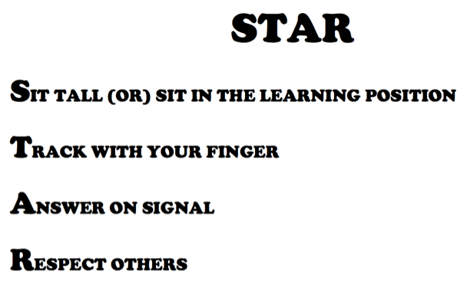
Notes:
Two-thirds of our students are at risk because they don’t have the reading skills essential to succeed in the classroom today or in society tomorrow.
But there’s a solution…
SRA FLEX Literacy, a comprehensive Reading and Language Arts Intervention System for students in Grades 3 & Above.

Slide 2
